Slide 1
Journey Presentation WEEK 3
Anisha Gupta (Batch- 4)

Slide 2
FOUNDATION COURSE

Slide 3

DAY 7: 28-08-2023
Worked on Case Study: Implemented a Seamless CI/CD Workflow for a Spring Boot Application
Project Management Setup: To manage the Agile/Scrum project's progress
Used Azure VM
Integrated Prometheus Monitoring
Docker Containerization
Azure Web App Configuration
Implemented GitHub Actions Workflow

Slide 4
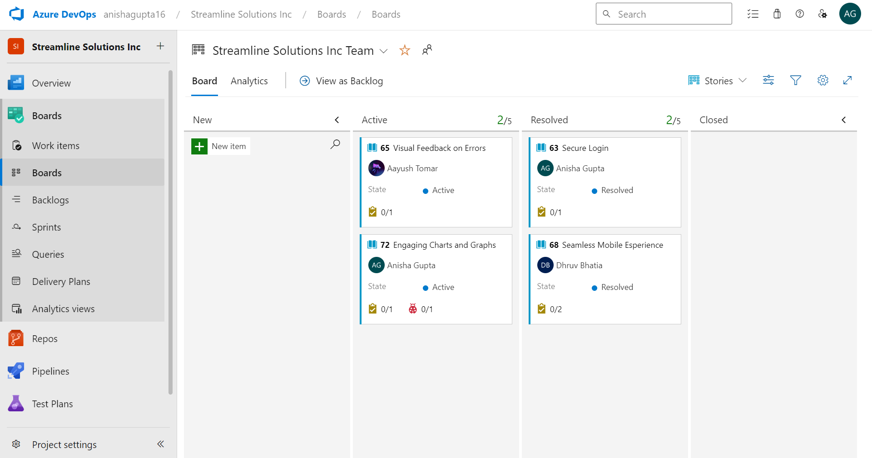
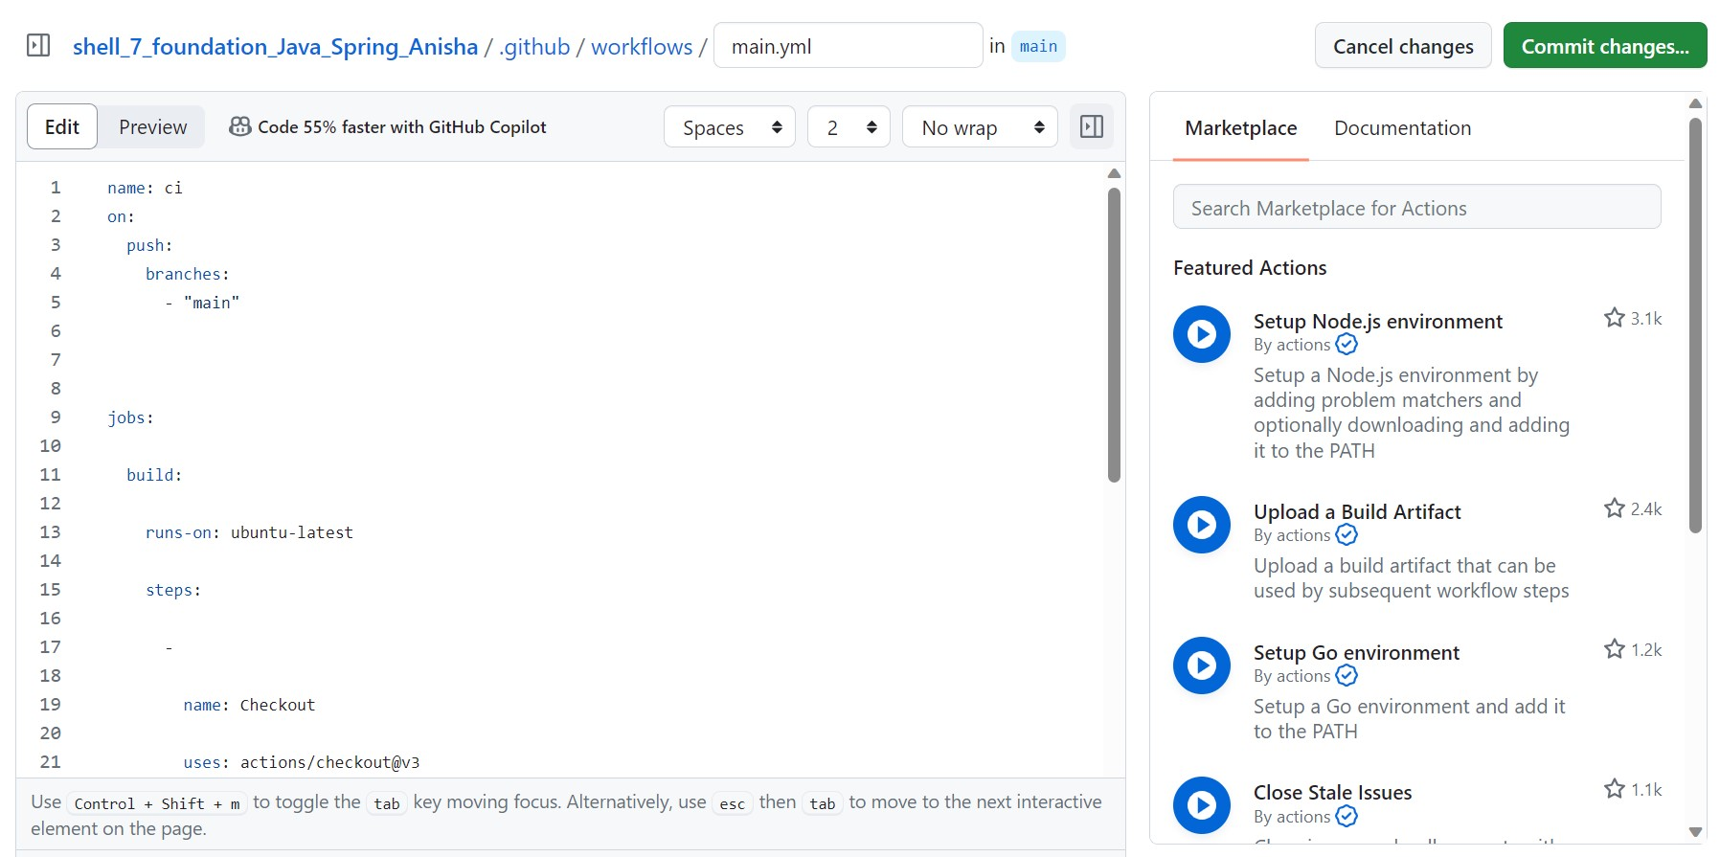
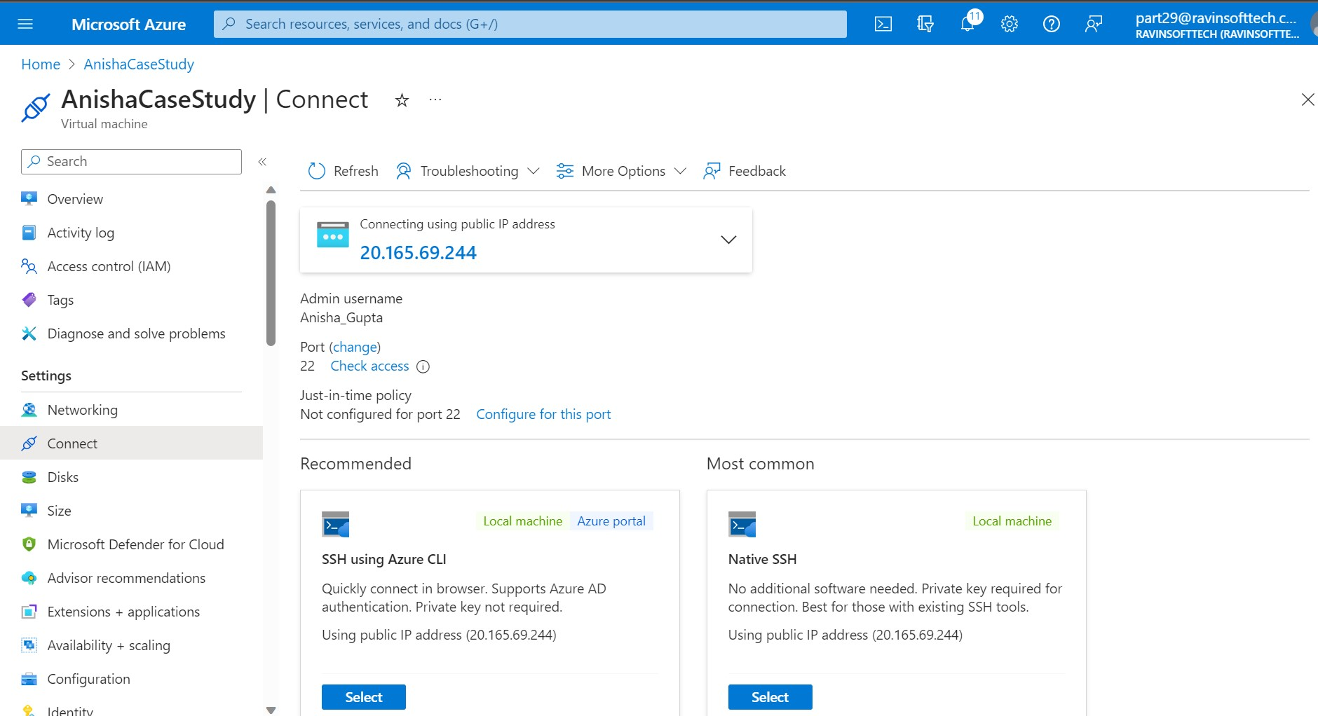
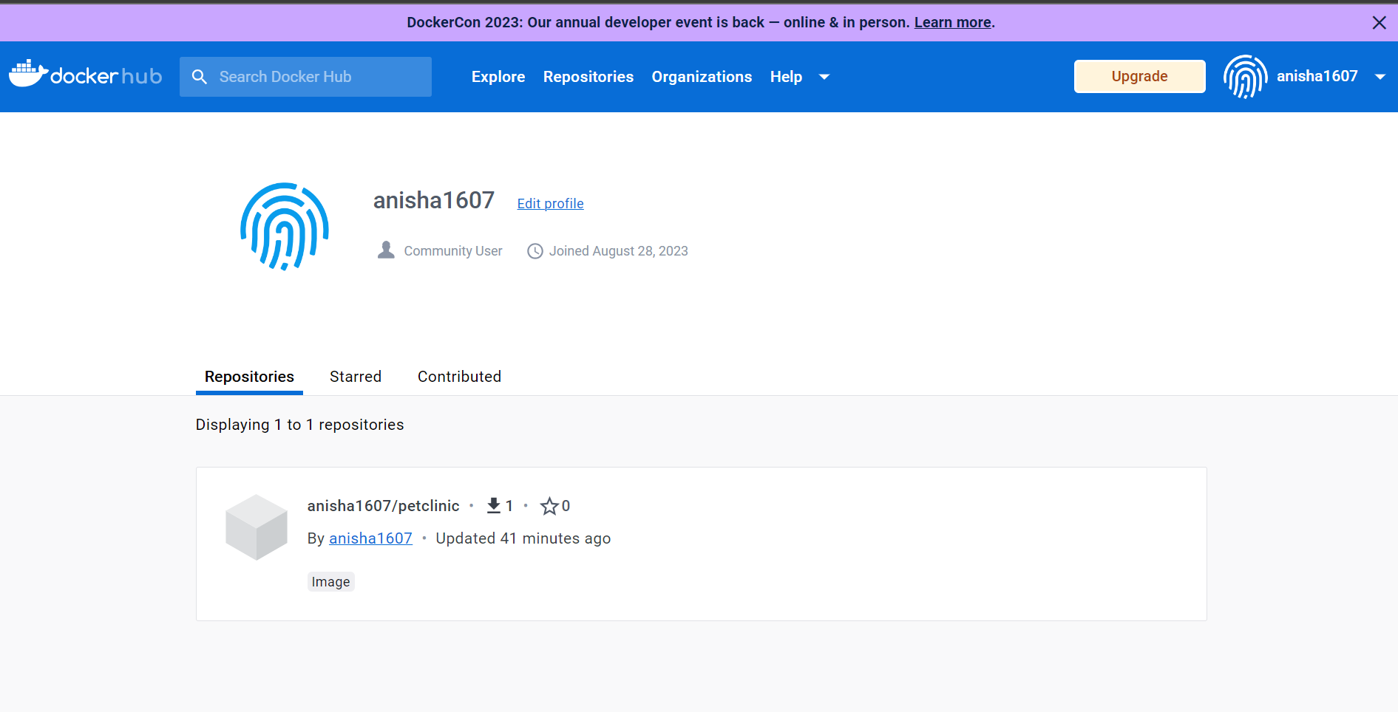

Slide 5
CUSTOM TRAINING

Slide 6
DAY 1: 29-08-2023
Introduced to Data Fundamentals – DBMS and Data Warehousing
In depth understanding of ER Modeling and did a Library Management System activity on it
Dimensional Modeling: Star Schema, Snowflake Schema and Galaxy Schema
Data Cube Operations: Roll Up, Slicing, Dicing, Rotation, Drill Down

Slide 7
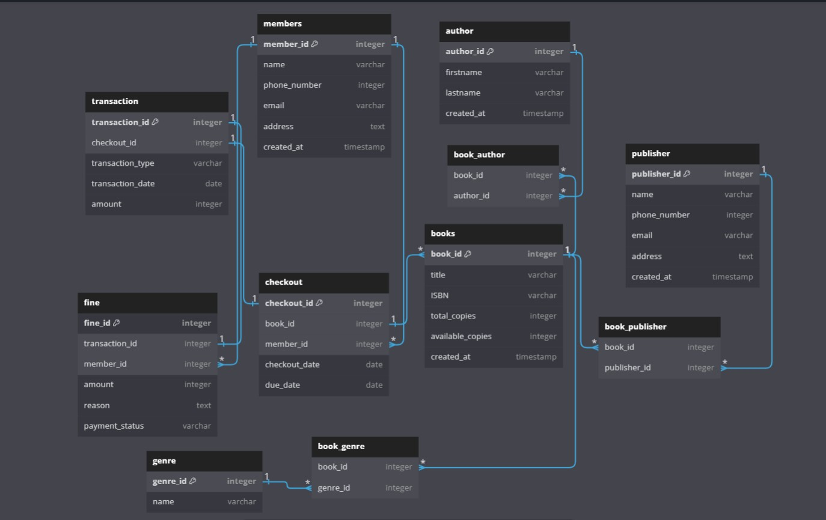

Slide 8
DAY 2: 30-08-2023
Got Introduced to NoSQL database: Key-Value DB (Redis), Document DB(MongoDB), Wide Column DB(Cassandra), Graph Based DB(neojs)
Overview on Big Data: Structured, Unstructured and Semi Structured Data
In a Data Lake, data is collected through an ELT (Extract, Load, Transform) process and stored in a raw, unstructured format.
The Data Lake can be divided into two primary parts: the Process Part, which tracks and manages data processing, and the Orchestrate Part, which handles metadata management.
When a Data Lake lacks proper management and becomes disorganized, it can devolve into a chaotic "Data Swamp.“
Data Governance practices are implemented to manage metadata, ensuring data quality, lineage, and accessibility.

Slide 9
DAY 3: 31-08-2023
Introduction to Microsoft Azure SQL and Query Editor
Did Hands on Practical on:
Making Schemas, Create, Alter, Drop with constraints
Filtering Data
Grouping data using group by and having
Aggregate Queries
Subqueries

Slide 10
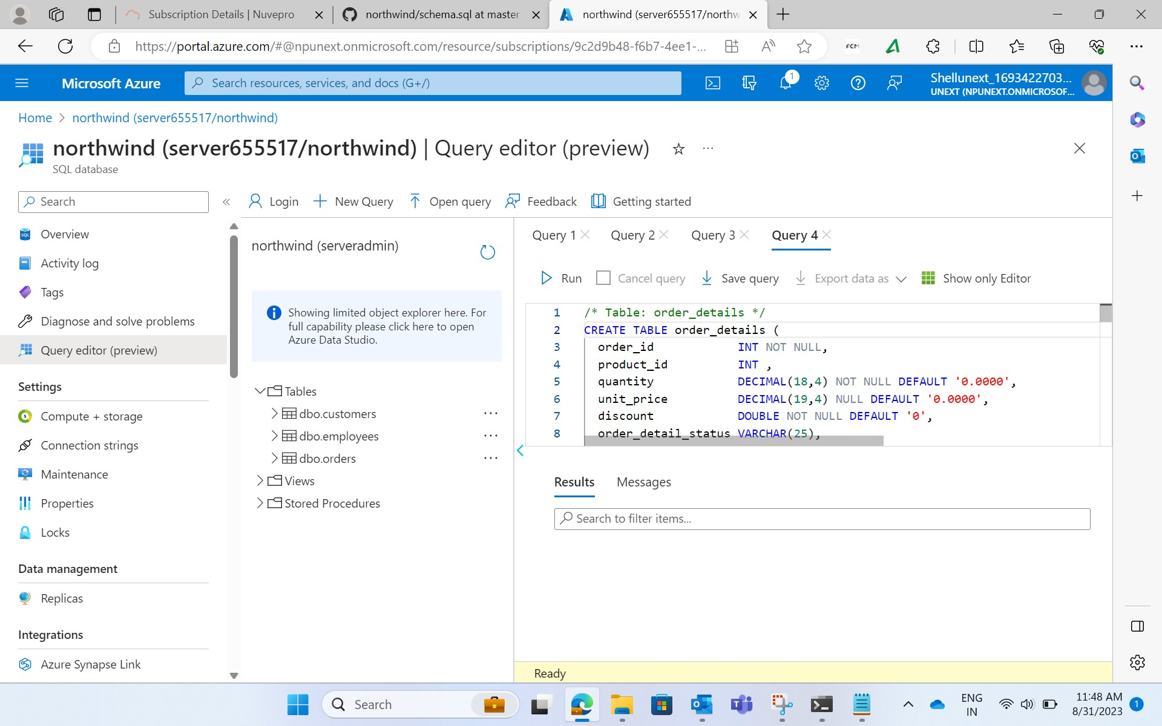

Slide 11
DAY 4: 1-09-2023
Had quiz to test our gained knowledge on Data Fundamentals & Azure Fundamentals
Did Hands on Practical in Azure SQL on:
Joins
Intersection and Unions
Subqueries
Overview on Stored Procedures
Indexes ( Heaps, Clustered and Non-Clustered)

Slide 12
